Slide 1

SALES INTERACTIVE DASHBOARD
Subtitle: Supermarket shop | built in power bi
Name: Mihir Aryan Mishra
Date: 26 oct, 2025
Tools: Power BI

Slide 2

OVERVIEW
Interactive Power BI dashboard for supermarket sales analysis.
Visualizes key metrics — Total Sales, Profit, and Profit %.
Identifies top products, categories, and payment trends.
Includes filters for year, month, sale type, and payment mode.
Designed with a dark modern theme for clear data insights.
Helps in quick, data-driven business decisions.

Slide 3
DATA SOURCES
Primary Datasets:
InputData.xlsx- Raw Sales Transaction
MasterData.xlsx- Product, Category and Payment Mode
Data Preparation Steps:
Cleaned and merged both datasets
Handled null values and duplicates
Created calculated columns for Profit and Profit %

Slide 4

KEY METRICS
KPIs Displayed on Dashboard:
🧾 Total Sales: 13K
💰 Total Profit: 2213
📈 Profit %: 21%
🏅 Top Category: 5K
🏆 Top Product: 3K

Slide 5
DASHBOARD DESIGN
Layout Features:
KPI cards placed at the top for quick performance insights.
Visuals organized into Monthly, Daily, Product, and Category sections for easy analysis.
Interactive filters for Year, Month, Sale Type, and Payment Mode to customize the view.
Design Approach:
Used a dark-themed background with bright accent colors for a clean, modern look.
Ensures readability, visual balance, and user engagement.
Focused on clarity and interactivity to enhance the decision-making experience.

Slide 6
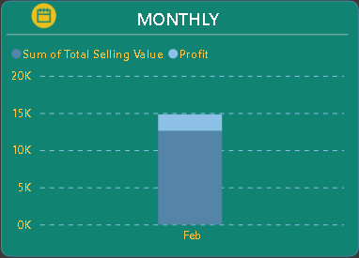
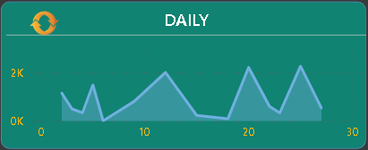
SALES TRENDS
Charts Used:
Monthly Trend: Bar chart comparing sales & profit.
Daily Trend: Line chart showing daily variations.
Insights:
February shows peak sales
Sales fluctuate moderately across the month

Slide 7
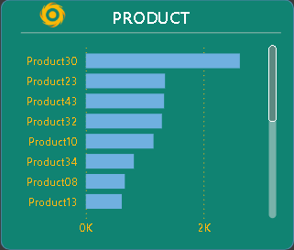
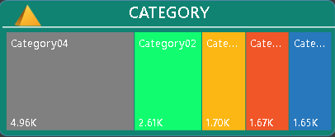
Product and Category Insights
Product Chart:
Top-selling products: Product30, Product23, Product43
Clear visualization of top performers.
Category Chart:
Category04 contributes the most sales (≈ 5K).
Others include Category02, Category03, Category05

Slide 8
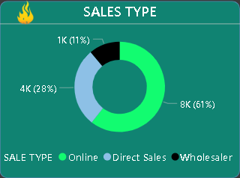
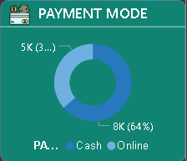
Sales Type & Payment Mode
Sales Type Donut Chart:
Online Sales: 61%
Direct Sales: 28%
Wholesale: 11%
Payment Mode Chart:
Cash: 64%
Online: 36%

Slide 9
Interactivity & Filters
Interactive Filters Used:
Year: 2021,2022
Month: January - December
Sale Type: Online, Direct, Wholesale
Payment Mode: Online, Cash
Functionality:
Dynamic filters update all visuals instantly for real-time comparison.
Allows users to drill down into specific periods, categories, or sales channels.
Enhances user control and dashboard flexibility for deeper analysis.

Slide 10
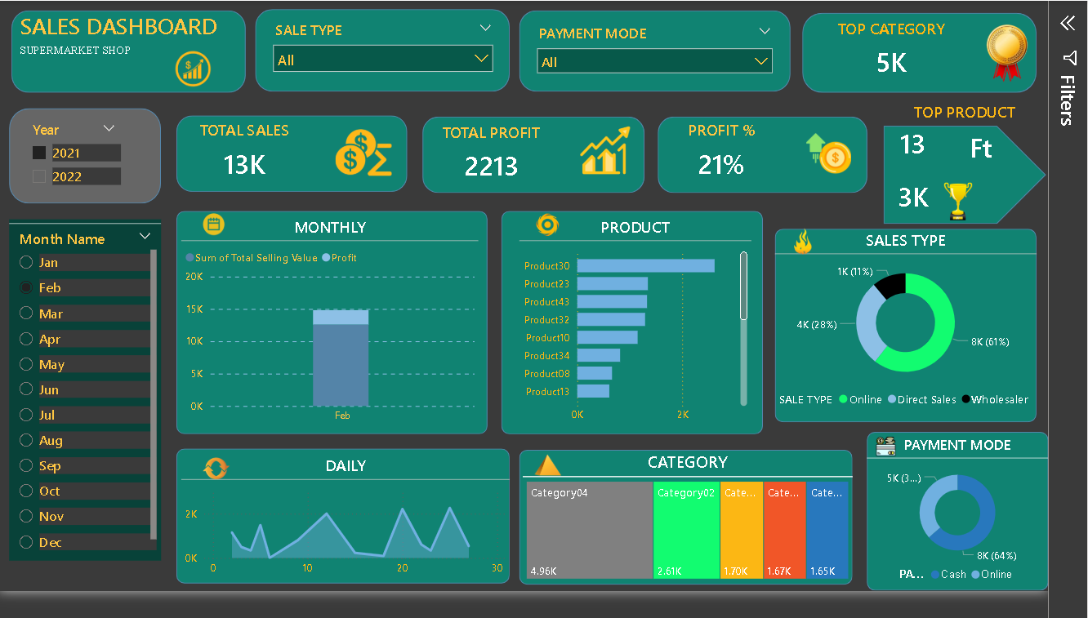
FULL LAYOUT Of THE DASHBOARD

Slide 11

Conclusion & Recommendations
Summary:
Sales performance shows steady growth.
Top products and categories identified for optimization.
Dashboard enables real-time decision making.
Recommendations:
Focus on high-performing categories
Expand online marketing for top products
Offer digital payment incentives to reduce cash dependency

Slide 12


